Slide 1
Auto Silent
By:
Nanda Kumar
Nehan Ashin Tony
Prajwal P
Sarvesh V

Slide 2

INTRODUCTION
Auto silent :- Profile switcher
Geofence :- Profile switcher

Slide 3
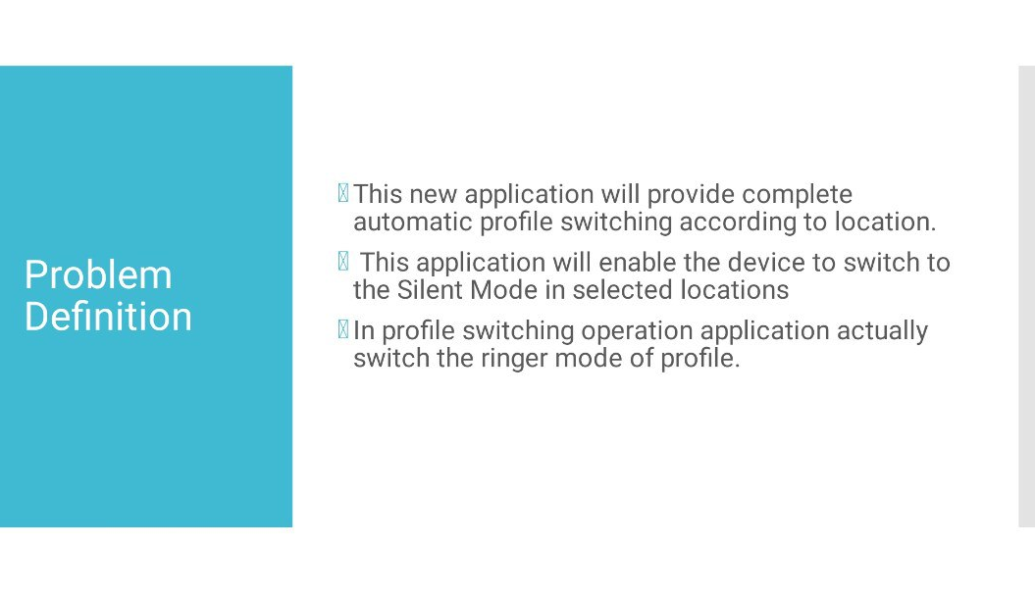

Slide 4
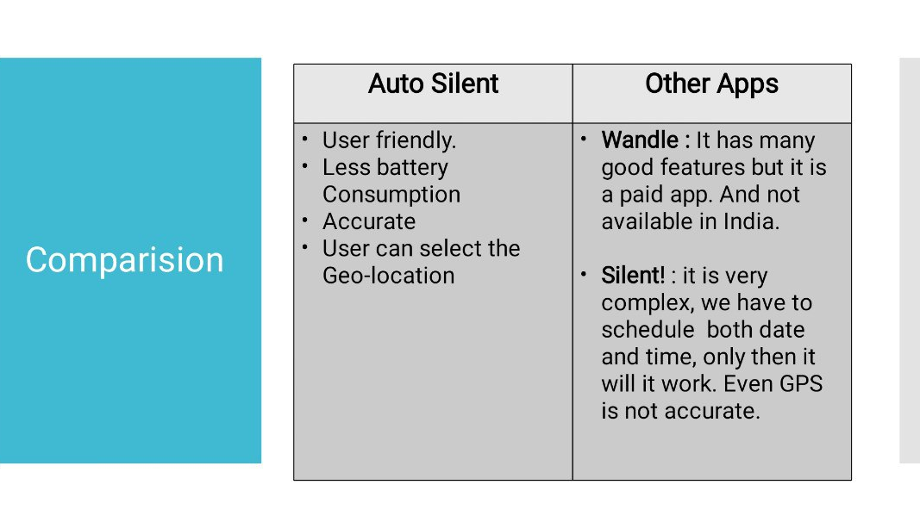

Slide 5
DATA FLOW DIAGRAM
DFD level(0) :- Select location and create geofence
User
Input Process
Application
Location
Geofence

Slide 6
DFD level(1) :- Processing to change to silent profile when entered the geofence
Request for Silent mode
Application
GeoFence Enter
Profile Changing process And notify
System
Request activated

Slide 7
DFD level(2) :- Monitor the location of the device and check for transition
Process to check location and monitoring geo-fence
Application
System
Dwell
Change in Transition State

Slide 8
DFD level(3) :- Changing the profile back to normal status after exiting the geofence
Process for changing profile back to noramal after leaving geo_fence and notify
Change to normal mode
Application
Exit from Geo-fence
System

Slide 9
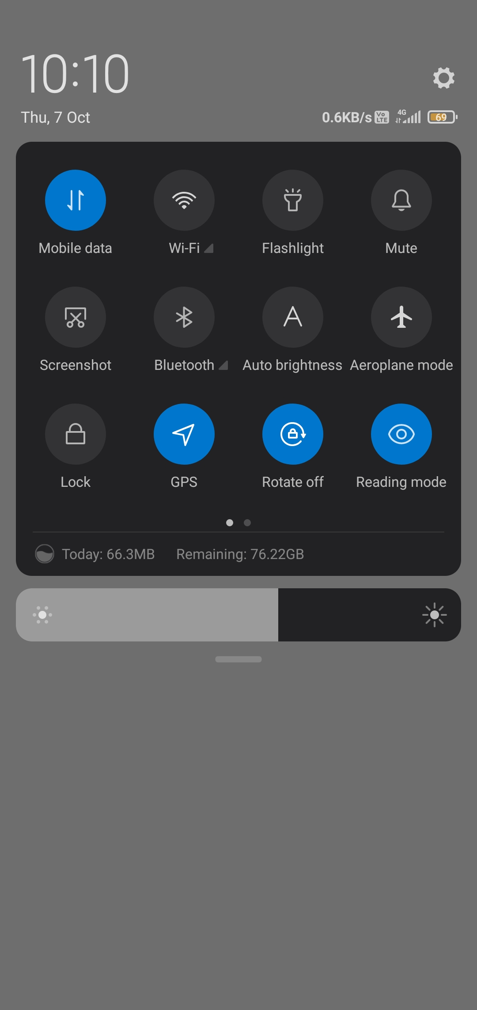
SCREENSHOT

Slide 10
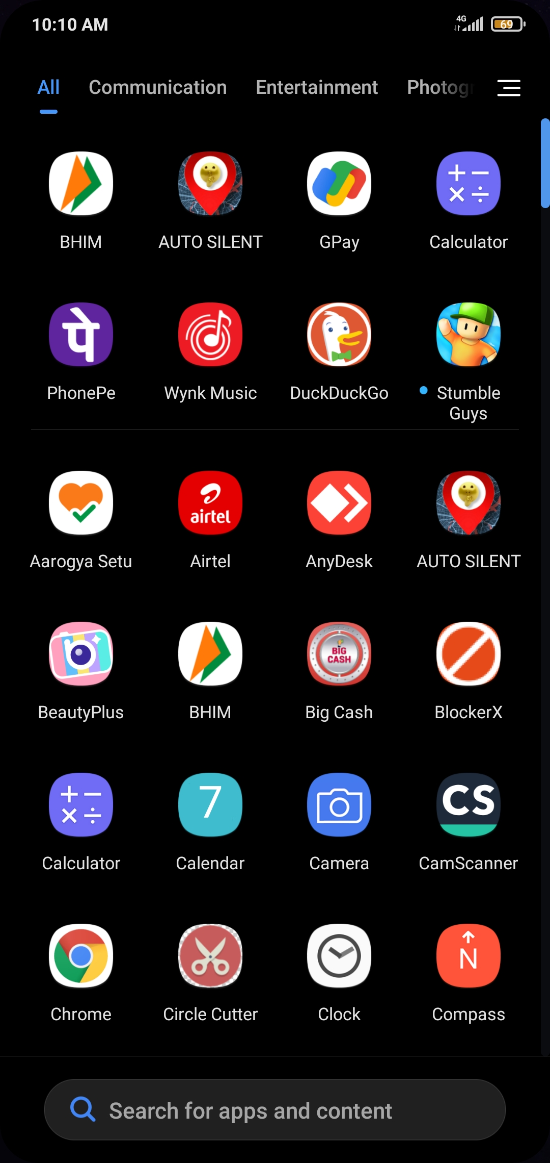

Slide 11
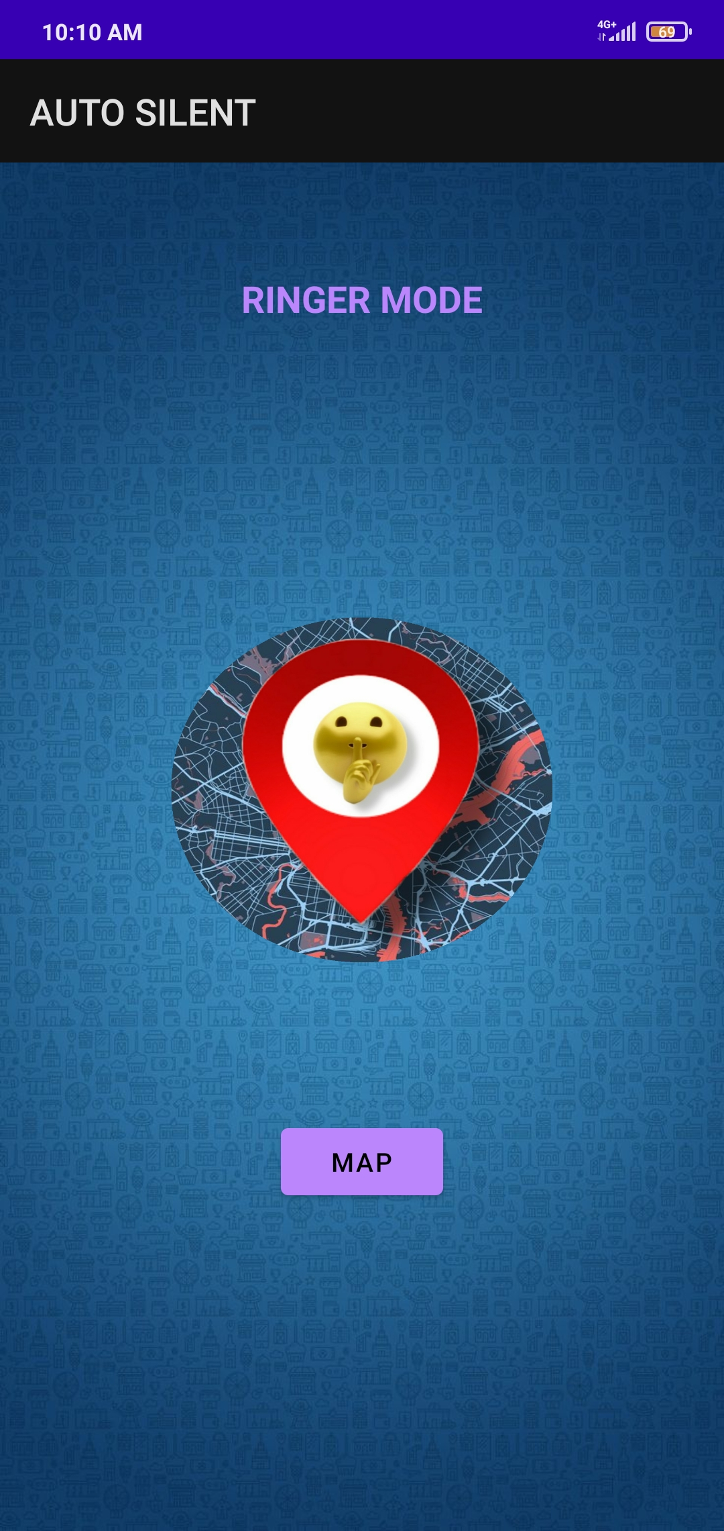

Slide 12
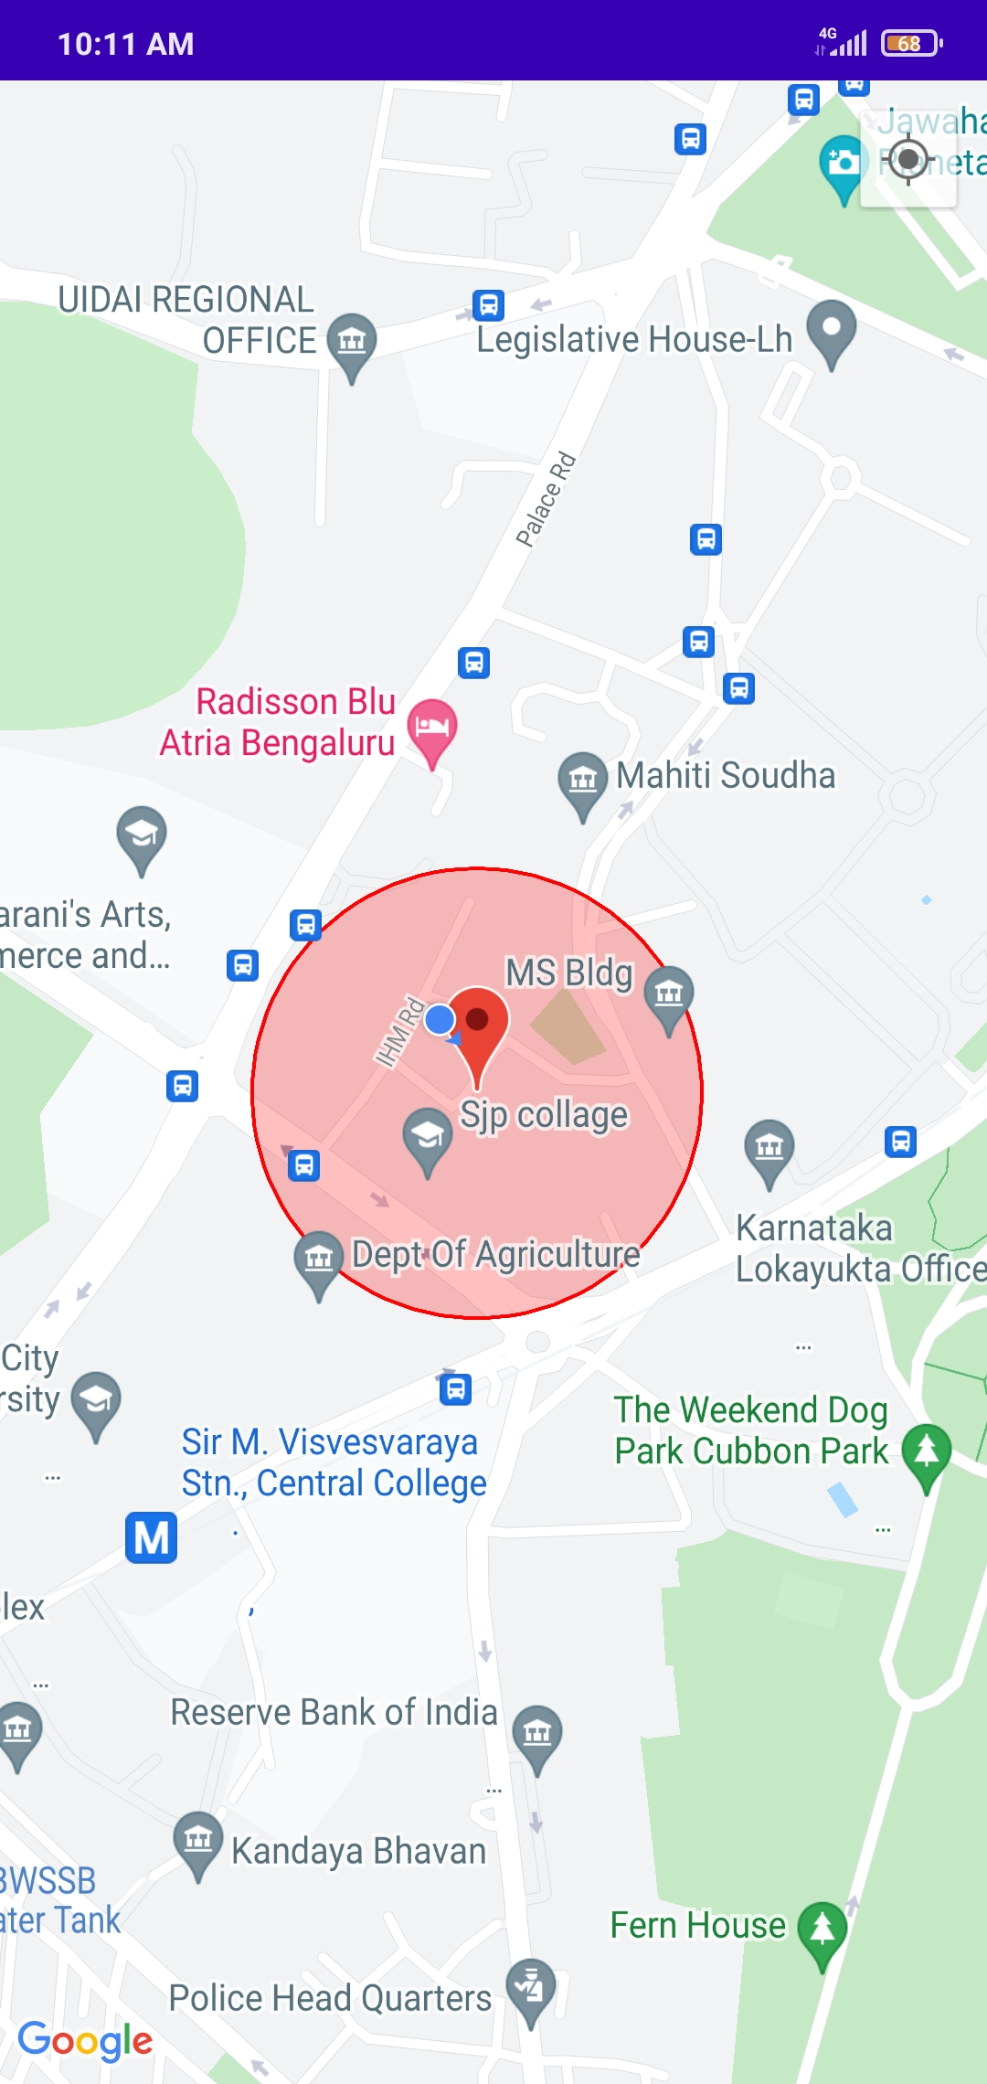

Slide 13
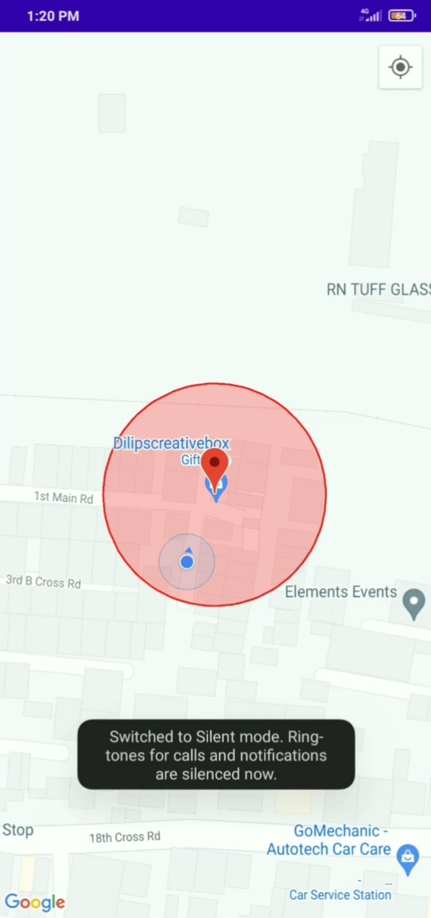

Slide 14
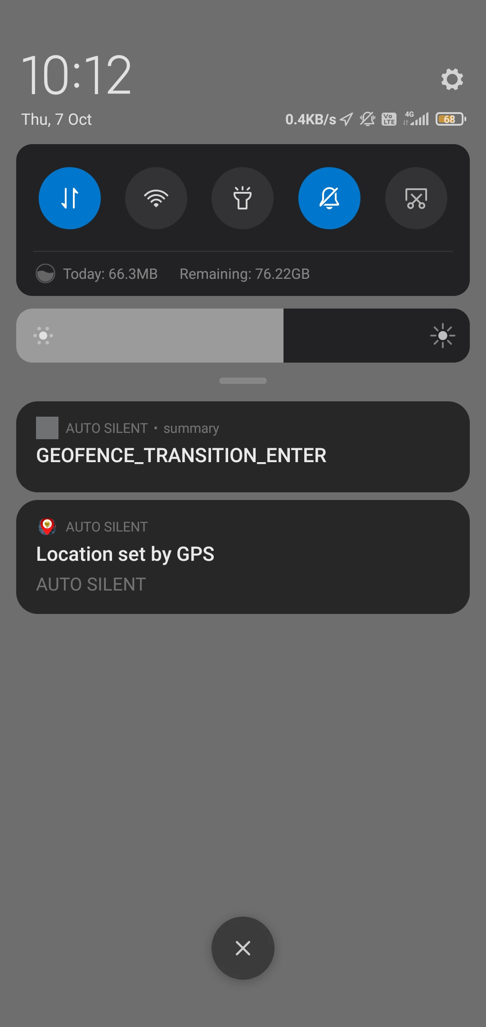

Slide 15
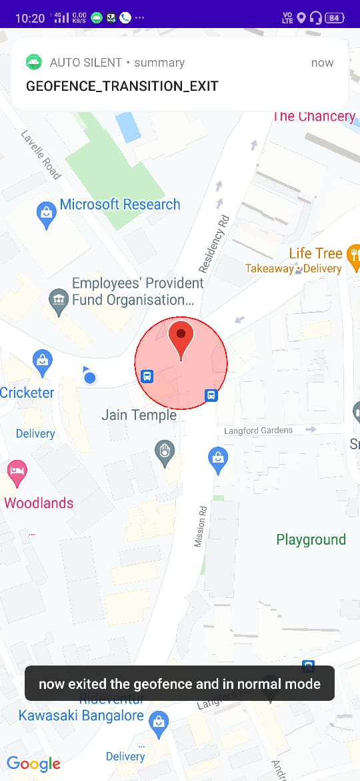

Slide 16
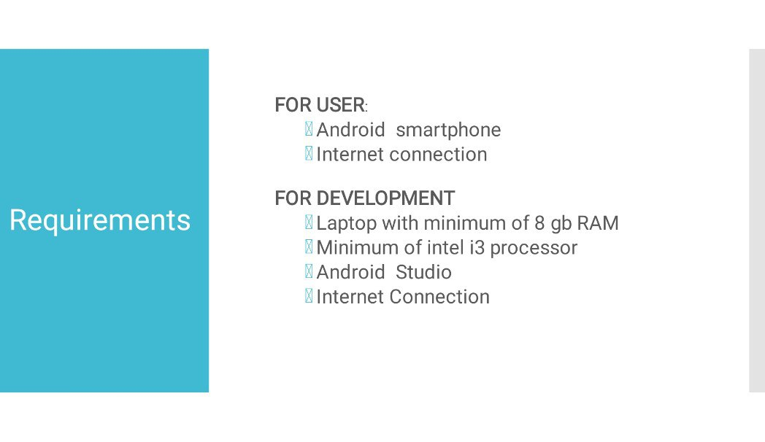

Slide 17
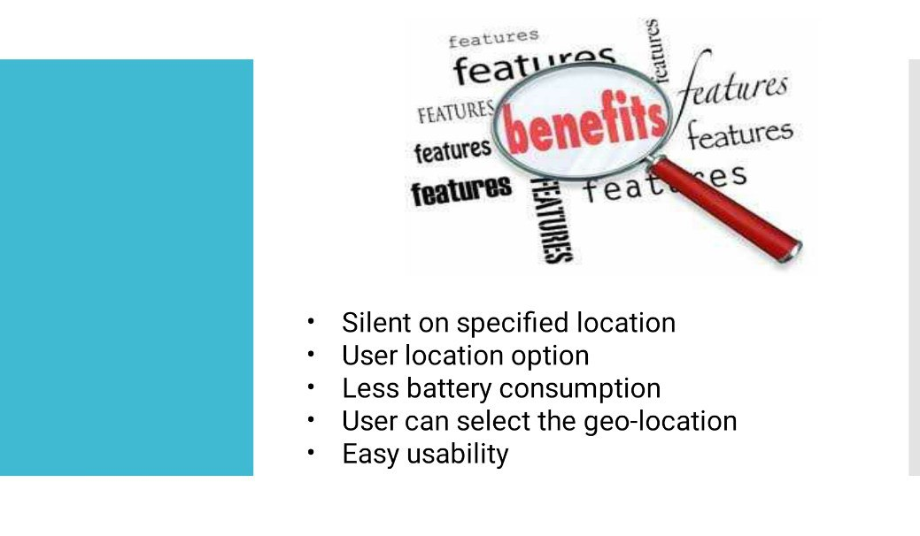

Slide 18
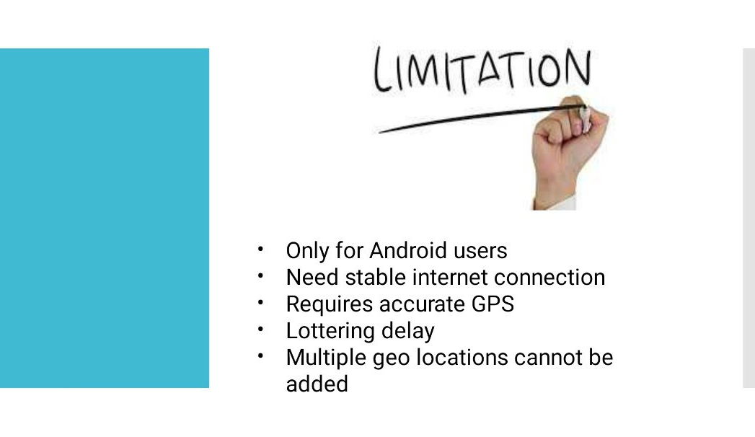

Slide 19
THANK YOU

